Slide 1
Clipping
Cohen-Sutherland Algo

Slide 2
Clipped view in screen

Slide 3
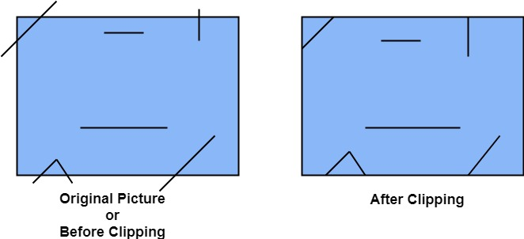
Line Clipping

Slide 4
A point (x,y) is not clipped if:
x_{min} ≤ x ≤ x_{max} AND y_{min} ≤ y ≤ y_{max}
otherwise it is clipped
P₄
Clipped
Clipped
Window
P₂
y_{max}
Clipped
P₅
P₅
P₁
P₇
P₁
Points Within the Window are Not Clipped
P₉
P₉
y_{min}
P₈
Clipped
P₁₀
x_{min}
x_{max}

Slide 5
P₄
Window
Window
y_{max}
y_{max}
P₆
P₆
P₃
P₅
P₅
P₇
P’₇
P₉
P₈
P₉
P’₈
y_{min}
y_{min}
P’₁₀
P₁₀
P₁₃
P₁₄
x_{min}
x_{max}
x_{min}
x_{max}

Slide 6
World space is divided into regions based on the window boundaries
Each region has a unique four bit outcode
Outcodes indicate the position of the regions with respect to the window
1001 | 1000 | 1010
0001 | 0000 Window | 0010
0101 | 0100 | 0110
3
2
1
0
above
below
right
left
Region Code

Slide 7
World space is divided into regions based on the window boundaries
Each region has a unique four bit outcode
Outcodes indicate the position of the regions with respect to the window
P₃
1001 | 1000 | 1010
0001 | 0000 Window | 0010
0101 | 0100 | 0110
3
2
1
0
above
below
right
left
P₄
P₁
Region Code
P₂

Slide 8
Calculate_outcode(x,y){
if (x<x_{min}) bit0 =1
else bit0=0
if (x>x_{max}) bit1=1
else bit1=0
if(y<y_{min}) bit2=1
else bit2=0
if (y>y_{max}) bit3=1
else bit3=0
}
3
2
1
0
above
below
right
left
Region Code

Slide 9
Calculate_Outcode_3D(x,y,z){
if (x<x_{min}) bit0 =1
else bit0=0
if (x>x_{max}) bit1=1
else bit1=0
if(y<y_{min}) bit2=1
else bit2=0
if (y>y_{max}) bit3=1
else bit3=0
if(z<z_{min}) bit4=1
else bit4=0
if (z>z_{max}) bit5=1
else bit5=0
}
5 | 4 | 3 | 2 | 1 | 0
Near | Far | Above | Below | Right | Left
Region Code

Slide 10
Calculate_outcode(x,y){
if (x<x_{min}) bit0 =1
else bit0=0
if (x>x_{max}) bit1=1
else bit1=0
if(y<y_{min}) bit2=1
else bit2=0
if (y>y_{max}) bit3=1
else bit3=0
}
P₁₁ [1010]
P₄ [1000]
Window
y_{max}
P₆ [0000]
P₃ [0001]
P₅ [0000]
P₁₂ [0010]
P₇ [0001]
P₉ [0000]
P₈ [0010]
y_{min}
P₁₀ [0100]
P₁₃ [0101]
P₁₄ [0110]
x_{min}
x_{max}
3
2
1
0
above
below
right
left
Region Code

Slide 11
cohen-Sutherland(x1, y1, x2, y2):
oc1 = calculate_outcode(x1, y1),
oc2 = calculate_outcode(x2, y2);
while(true) {
if(oc1 == oc2 == 0000) {
//declare completely inside
output (x1, y1), (x2, y2) as clipped line
break
}
else if((oc1 AND oc2)!=0000){ // condition to check matching bit
//declare completely outside and clip
break
}
else{
if(oc1 != 0000){
(x1, y1) = find intersection point of line
and the boundary corresponding
to non-zero bit of oc1
oc1 = calculate_outcode(x1, y1)
}
else{
(x2, y2) = find intersection point of line
and the boundary corresponding
to non-zero bit of oc2
oc2 = calculate_outcode(x2, y2)
}
continue
}

Slide 12
cohen-Sutherland(x1, y1, x2, y2):
oc1 = calculate_outcode(x1, y1),
oc2 = calculate_outcode(x2, y2);
while(true) {
if (oc1 == oc2 == 0000) {
//declare completely inside
output (x1, y1), (x2, y2) as clipped line
break
}
else if ((oc1 AND oc2)!=0000) { // condition to check matching bit
//declare completely outside and clip
break
}
else{
if(oc1 != 0000){
(x1, y1) = find intersection point of line
and the boundary corresponding
to non-zero bit of oc1
oc1 = calculate_outcode(x1, y1)
}
else{
(x2, y2) = find intersection point of line
and the boundary corresponding
to non-zero bit of oc2
oc2 = calculate_outcode(x2, y2)
}
continue
}
P₂ [1010]
Window
y_{max}
y_{min}
P₁ [0101]
x_{min}
x_{max}

Slide 13
cohen-Sutherland(x1, y1, x2, y2):
oc1 = calculate_outcode(x1, y1),
oc2 = calculate_outcode(x2, y2);
while(true) {
if (oc1 == oc2 == 0000) {
//declare completely inside
output (x1, y1), (x2, y2) as clipped line
break
}
else if ((oc1 AND oc2)!=0000) { // condition to check matching bit
//declare completely outside and clip
break
}
else{
if(oc1 != 0000){
(x1, y1) = find intersection point of line
and the boundary corresponding
to non-zero bit of oc1
oc1 = calculate_outcode(x1, y1)
}
else{
(x2, y2) = find intersection point of line
and the boundary corresponding
to non-zero bit of oc2
oc2 = calculate_outcode(x2, y2)
}
continue
}
P₂ [1010]
Window
y_{max}
y_{min}
P₁’ [0001]
x_{min}
x_{max}

Slide 14
cohen-Sutherland(x1, y1, x2, y2):
oc1 = calculate_outcode(x1, y1),
oc2 = calculate_outcode(x2, y2);
while(true) {
if (oc1 == oc2 == 0000) {
//declare completely inside
output (x1, y1), (x2, y2) as clipped line
break
}
else if ((oc1 AND oc2)!=0000) { // condition to check matching bit
//declare completely outside and clip
break
}
else{
if(oc1 != 0000){
(x1, y1) = find intersection point of line
and the boundary corresponding
to non-zero bit of oc1
oc1 = calculate_outcode(x1, y1)
}
else{
(x2, y2) = find intersection point of line
and the boundary corresponding
to non-zero bit of oc2
oc2 = calculate_outcode(x2, y2)
}
continue
}
P₂ [1010]
Window
y_{max}
P₁’’ [0000]
y_{min}
x_{min}
x_{max}

Slide 15
cohen-Sutherland(x1, y1, x2, y2):
oc1 = calculate_outcode(x1, y1),
oc2 = calculate_outcode(x2, y2);
while(true) {
if (oc1 == oc2 == 0000) {
//declare completely inside
output (x1, y1), (x2, y2) as clipped line
break
}
else if ((oc1 AND oc2)!=0000) { // condition to check matching bit
//declare completely outside and clip
break
}
else{
if(oc1 != 0000){
(x1, y1) = find intersection point of line
and the boundary corresponding
to non-zero bit of oc1
oc1 = calculate_outcode(x1, y1)
}
else{
(x2, y2) = find intersection point of line
and the boundary corresponding
to non-zero bit of oc2
oc2 = calculate_outcode(x2, y2)
}
continue
}
Window
y_{max}
P₂ ’ [0000]
P₁’’ [0000]
y_{min}
x_{min}
x_{max}

Slide 16
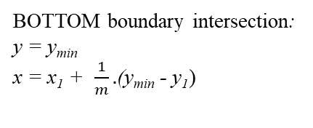
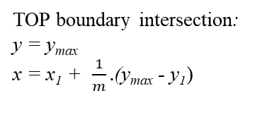
P₂
(x, y)
P₂
y_{max}
y_{max}
(x, y)
y_{min}
y_{min}
LEFT boundary intersection:
x = x_{min} y = y₁ + m (x_{min} - x₁)
P₁
RIGHT boundary intersection:
x = x_{max} y = y₁ + m (x_{max} - x₁)
P₁
x_{min}
x_{max}
x_{min}
x_{max}
P₂
P₂
(x, y)
y_{max}
y_{max}
(x, y)
y_{min}
y_{min}
P₁
P₁
x_{min}
x_{max}
x_{min}
x_{max}

Slide 17
Determine whether the following line are accepted/rejected/partial using Cohen Sutherland line clipping algorithm.
a) Given (-250,-200) to (250,200) be the clip region.
(i) (-100, -220) to (300, -210).
(ii) (-250, 200) to (250, -200).
b) Given (0,0) to (300,200) be the clip region.
(i) (50, -125) to (-100, 225).
(ii) (-250, 200) to (250, -200).
If they are partially accepted/rejected find the line segment within the clipping window.

Slide 18
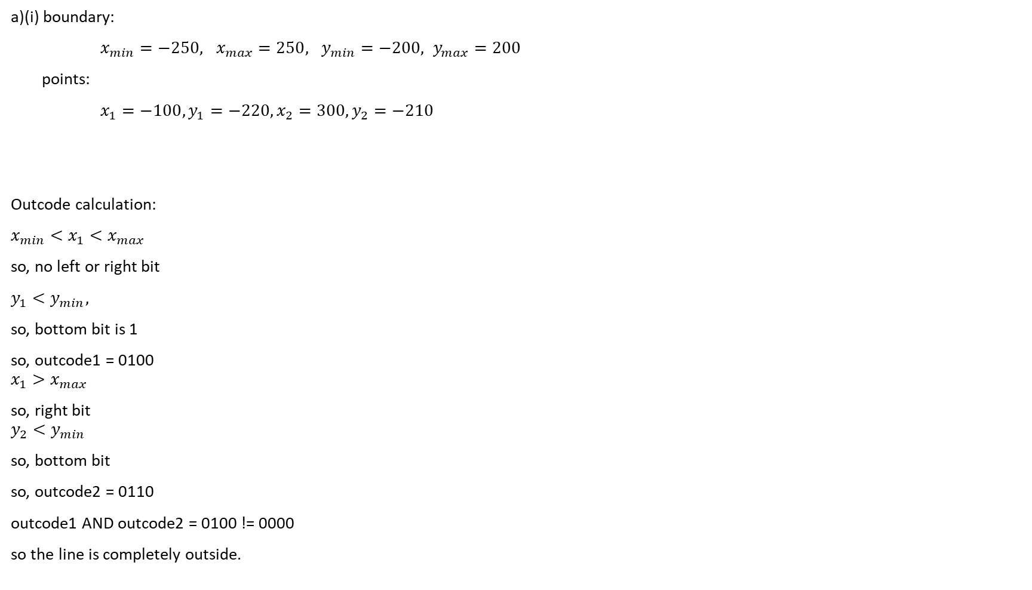
cohen-Sutherland(x1, y1, x2, y2):
oc1 = calculate_outcode(x1, y1),
oc2 = calculate_outcode(x2, y2);
while(true) {
if (oc1 == oc2 == 0000) {
//declare completely inside
output (x1, y1), (x2, y2) as clipped line
break
}
else if ((oc1 AND oc2)!=0000) { // condition to check matching bit
//declare completely outside and clip
break
}
else{
if(oc1 != 0000){
(x1, y1) = find intersection point of line
and the boundary corresponding
to non-zero bit of oc1
oc1 = calculate_outcode(x1, y1)
}
else{
(x2, y2) = find intersection point of line
and the boundary corresponding
to non-zero bit of oc2
oc2 = calculate_outcode(x2, y2)
}
continue
}

Slide 19
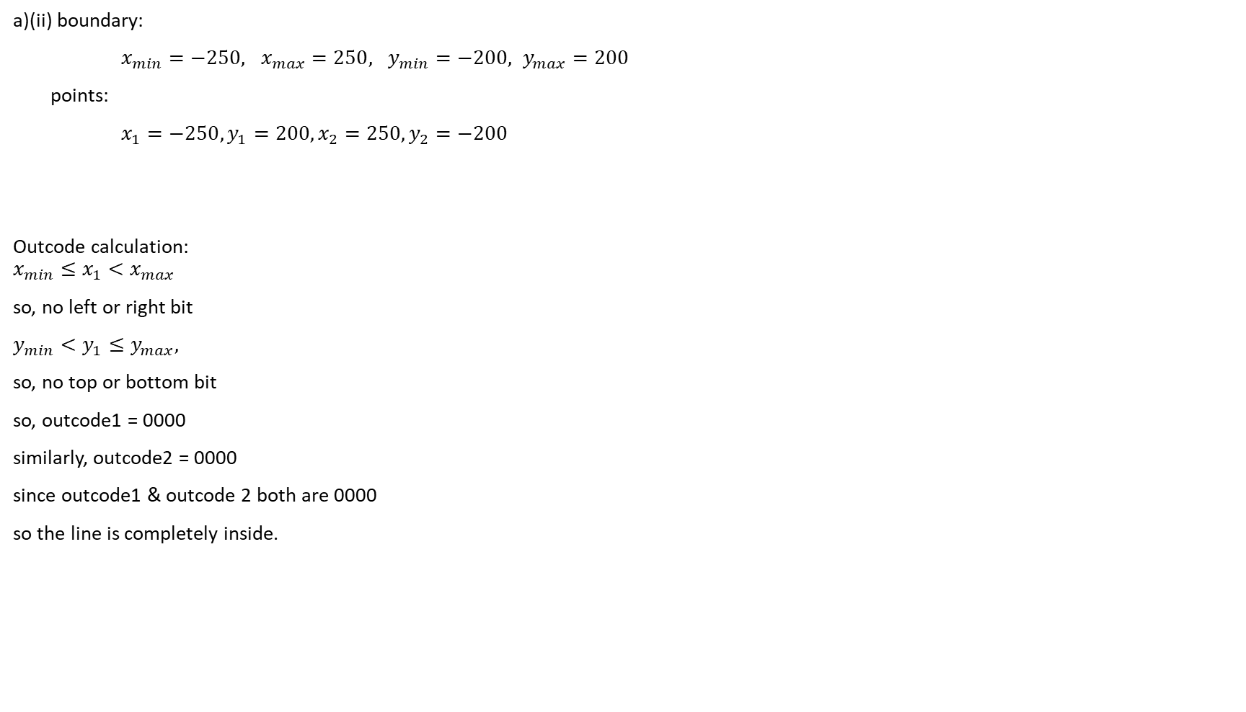
cohen-Sutherland(x1, y1, x2, y2):
oc1 = calculate_outcode(x1, y1),
oc2 = calculate_outcode(x2, y2);
while(true) {
if (oc1 == oc2 == 0000) {
//declare completely inside
output (x1, y1), (x2, y2) as clipped line
break
}
else if ((oc1 AND oc2)!=0000) { // condition to check matching bit
//declare completely outside and clip
break
}
else{
if(oc1 != 0000){
(x1, y1) = find intersection point of line
and the boundary corresponding
to non-zero bit of oc1
oc1 = calculate_outcode(x1, y1)
}
else{
(x2, y2) = find intersection point of line
and the boundary corresponding
to non-zero bit of oc2
oc2 = calculate_outcode(x2, y2)
}
continue
}

Slide 20
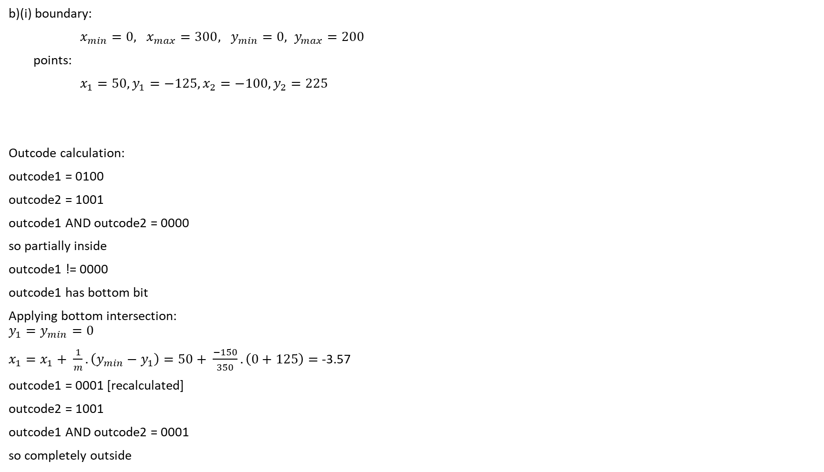
cohen-Sutherland(x1, y1, x2, y2):
oc1 = calculate_outcode(x1, y1),
oc2 = calculate_outcode(x2, y2);
while(true) {
if (oc1 == oc2 == 0000) {
//declare completely inside
output (x1, y1), (x2, y2) as clipped line
break
}
else if ((oc1 AND oc2)!=0000) { // condition to check matching bit
//declare completely outside and clip
break
}
else{
if(oc1 != 0000){
(x1, y1) = find intersection point of line
and the boundary corresponding
to non-zero bit of oc1
oc1 = calculate_outcode(x1, y1)
}
else{
(x2, y2) = find intersection point of line
and the boundary corresponding
to non-zero bit of oc2
oc2 = calculate_outcode(x2, y2)
}
continue
}

Slide 21
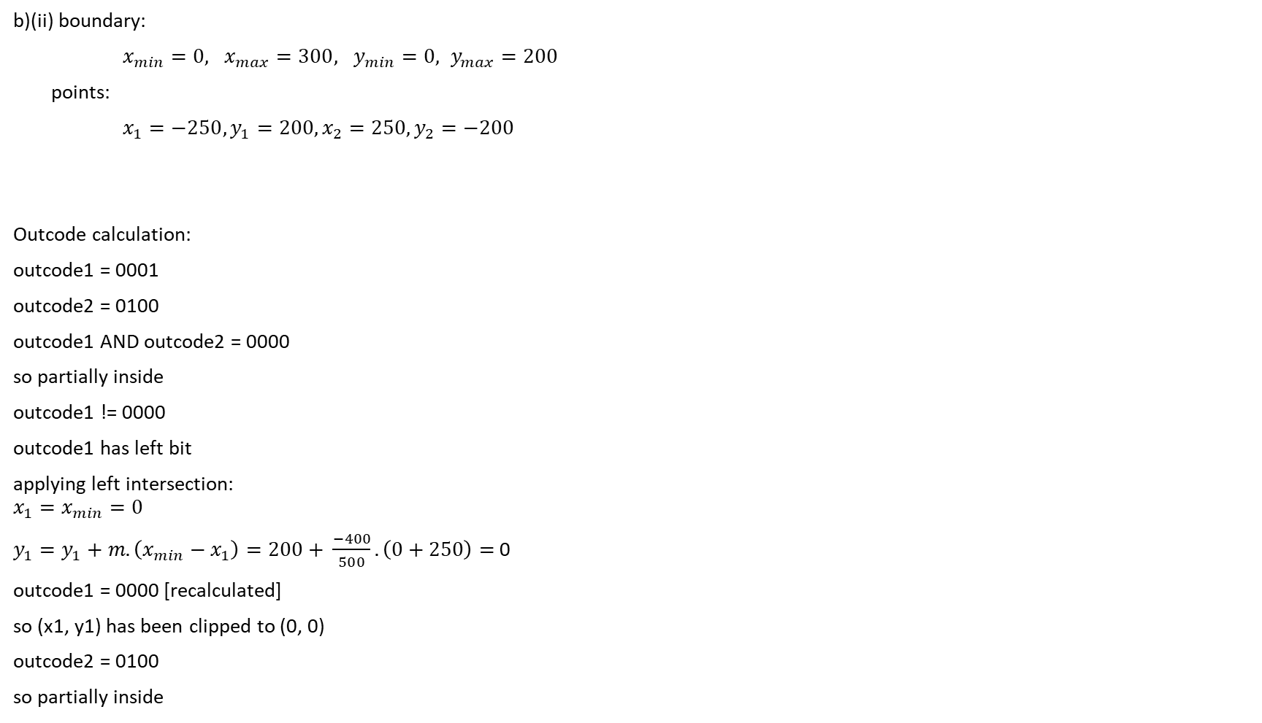
cohen-Sutherland(x1, y1, x2, y2):
oc1 = calculate_outcode(x1, y1),
oc2 = calculate_outcode(x2, y2);
while(true) {
if (oc1 == oc2 == 0000) {
//declare completely inside
output (x1, y1), (x2, y2) as clipped line
break
}
else if ((oc1 AND oc2)!=0000) { // condition to check matching bit
//declare completely outside and clip
break
}
else{
if(oc1 != 0000){
(x1, y1) = find intersection point of line
and the boundary corresponding
to non-zero bit of oc1
oc1 = calculate_outcode(x1, y1)
}
else{
(x2, y2) = find intersection point of line
and the boundary corresponding
to non-zero bit of oc2
oc2 = calculate_outcode(x2, y2)
}
continue
}

Slide 22
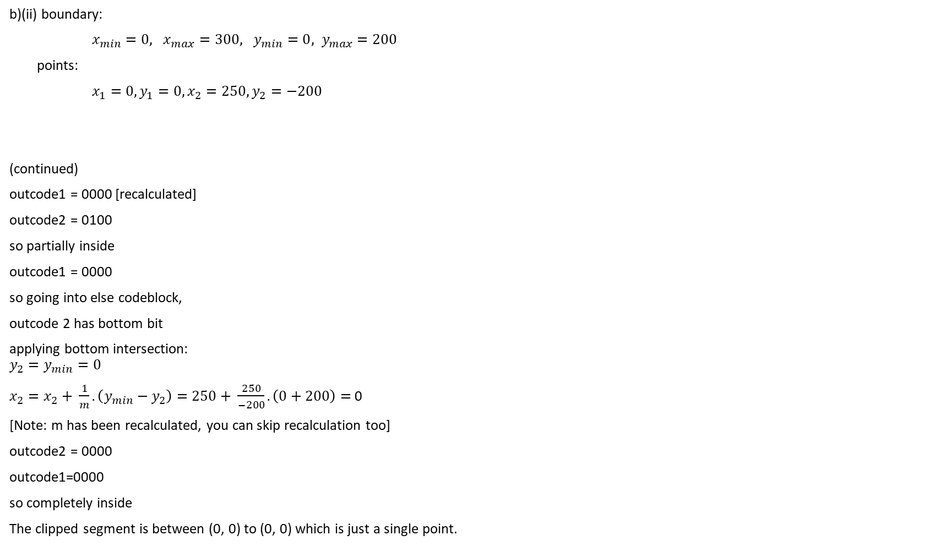
cohen-Sutherland(x1, y1, x2, y2):
oc1 = calculate_outcode(x1, y1),
oc2 = calculate_outcode(x2, y2);
while(true) {
if (oc1 == oc2 == 0000) {
//declare completely inside
output (x1, y1), (x2, y2) as clipped line
break
}
else if ((oc1 AND oc2)!=0000) { // condition to check matching bit
//declare completely outside and clip
break
}
else{
if(oc1 != 0000){
(x1, y1) = find intersection point of line
and the boundary corresponding
to non-zero bit of oc1
oc1 = calculate_outcode(x1, y1)
}
else{
(x2, y2) = find intersection point of line
and the boundary corresponding
to non-zero bit of oc2
oc2 = calculate_outcode(x2, y2)
}
continue
}

